Slide 1
Engagement HQ
Customer Experience Team
Notes:
This is Engagement HQ.
An online engagement and consultation platform used by Hull City Council.

Slide 2
Agenda Items
What is Engagement HQ
How it can be used
Types of conversations
Tools
Notes:
This PowerPoint includes –
What is Engagement HQ
How it can be used
Different tools available within the platform
Screenshots and their different uses
Questions

Slide 3
What is Engagement HQ?
Engagement HQ is a platform that allows customers to have their say in many ways, from surveys to discussion forums, quick polls and questions. They can share ideas, discuss important topics, and provide feedback in matters that are important to them, to help shape the development of the city and council services.
Suitable engagement projects will be set up as individual projects on the platform. The home page of the site includes one, larger, “featured project” (Let’s Talk About Hull’s Future: Hull’s Community Strategy in the example below), followed by an unlimited number of additional projects (under the “Further Consultations and Surveys” header. These additional projects can be split into different groups / themes.

Slide 4
…. continued
Users can sign up to become members of the site.
This is not mandatory – and, with few exceptions, engagement projects included on the platform should be available to all users without registering.
However, by registering users can be invited / have their attention drawn to specific consultations and surveys.
Users can receive updates in the form of newsletters
The main types of tools include –
surveys
quick polls
forum
live map tool *Additional tools are available
Notes:
It is an engagement and consultation platform, hosted externally to the council, but used internally for a range of different applications.
It offers a wide variety of different tools that can be used.
Each project can be carefully managed using different analysis tools that are available on the platform.

Slide 5
Types of conversation
The platform can be used to –
Inform
The platform is used to inform the public about plans and proposals, the next steps to projects and provide important updates.
Engage
Individuals can have their say on projects, provide feedback, and/or have the opportunity to influence decision making.
Feedback The results of projects will be published demonstrating how customers views are considered.

Slide 6
How is it used
Create a project or campaign
Promote a project or campaign
Project delivery
Provide project updates and/or feedback

Slide 7
Tools
Surveys Capture quantifiable data using a variety of question types and rich media.
Surveys allow you to capture quantifiable data to generate ideas, points of view, issues and opportunities.
People are generally used to filling them in, so you tend to generate high response rates
Who can complete a survey
Anyone – Anyone can participate on this topic – registration not required
Unverified – Anyone with an email and screen name can participate (recommended)
Registered single – Registered participants only. Users have to register on EHQ for an account. One survey submission per project permitted.

Slide 8
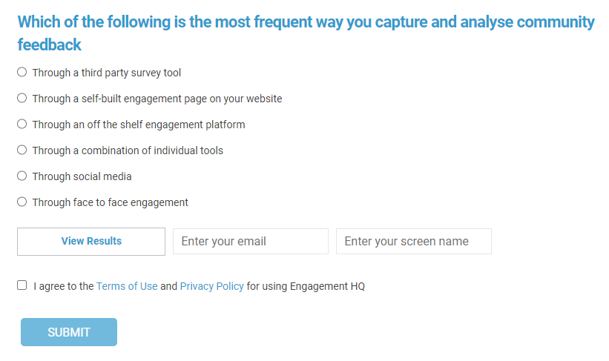
Tools
Quick Polls From a quick poll, you can ask a simple question to receive a quick response.
Quick polls allow you to ask a single question and capture a snapshot of sentiment or priorities!
It is a way to easily poll your community or project participants to assess general perceptions and capture a snapshot regarding a topic or issue

Slide 9
Tools
Forums
These are the most open tool that can be used by
customers.
Starting a discussion topic can be by asking a question and adding media to introduce the topic.
As a minimum all users would have to provide an email address in order to take part.
Forums are moderated 24/7 to prevent offensive or inappropriate behaviour.

Slide 10
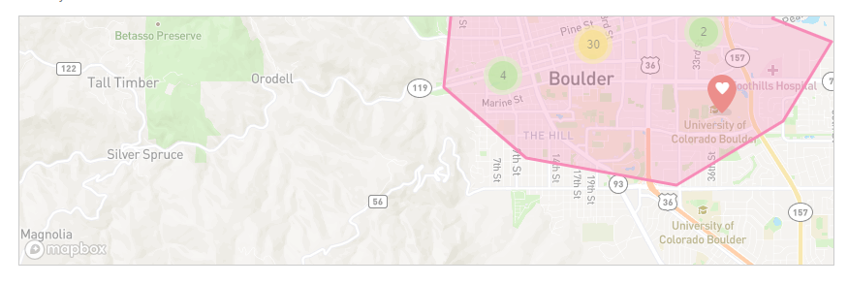
Tools
Maps Interactive maps to gather –
Comments
Surveys
Photos on a map
With a pin drop
Unlimited maps per project page
Select from 200+ pin category icons
Customers can click on a pin to discover a feature of the map
Customers can also drop their own pin to ask a question or leave a comment.

Slide 11
Tools
Guestbook An alternative to the Forum.
Simple online feedback without the dialogue. A safe space for your community to provide comments.
Customers can contact us without having to answer a specific question.
This is a safe, moderated space for your community to upload comments.
It is designed to gather text-based feedback from participants without community dialogue or debate.
It is useful for gathering feedback on highly emotional subjects when the choices are contrasted for example between limited or two opposing options.

Slide 12
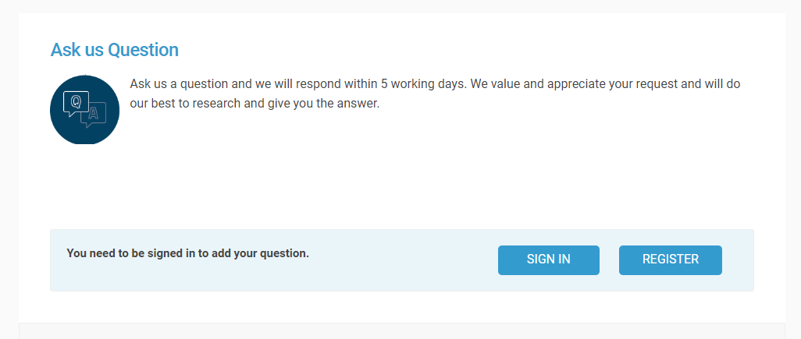
Tools
Q&A Just like any public meeting, people will ask questions. Q&A allows them to do just that.
Q&A is an issues management and communication risk mitigation tool.
It is a managed space for your community to ask you questions and for you to respond either publicly (to create a Q&A library) or privately.

Slide 13
Questions

